Slide 1
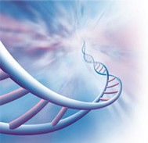
The Molecular Basis of Inheritance
Campbell
Chapter 16

Slide 2
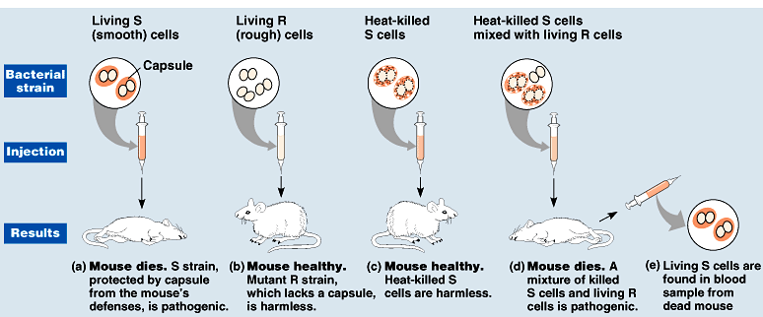
MOUSE EXPERIMENTS
In 1928, Frederick Griffith was looking for a pneumonia vaccine
Conducted the following 4 experiments
What did it mean?
Transformation

Slide 3
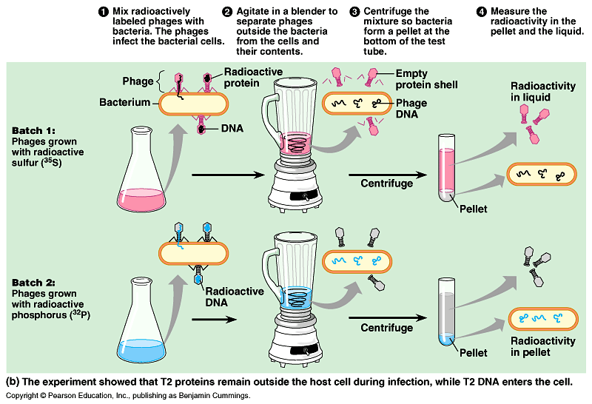
ALFRED HERSHEY & MARTHA CHASE~1952

Slide 4
Race to Solve the Puzzle
So if DNA are the instructions of life, what is its structure?
Erwin Chargaff discovered that DNA was composed of nucleotides
T(hymine), A(denine), C(ytosine), & G(uanine)
Linus Pauling, Maurice Wilkins & Rosalind Franklin, and two relatively unknown scientists: James Watson & Francis Crick were all a part of the race

Slide 5
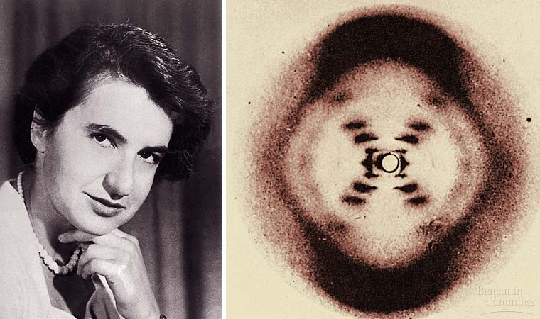

Slide 6
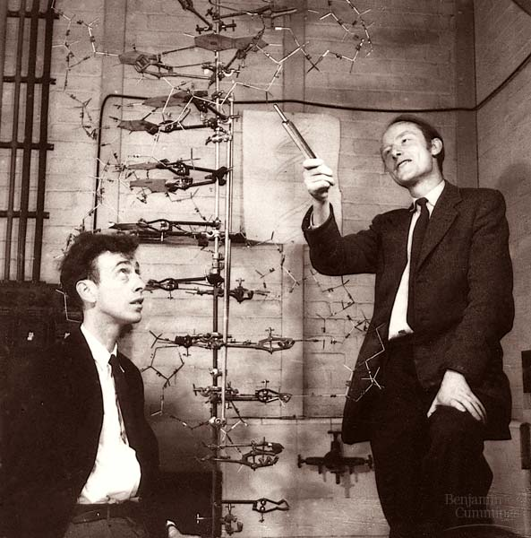

Slide 7
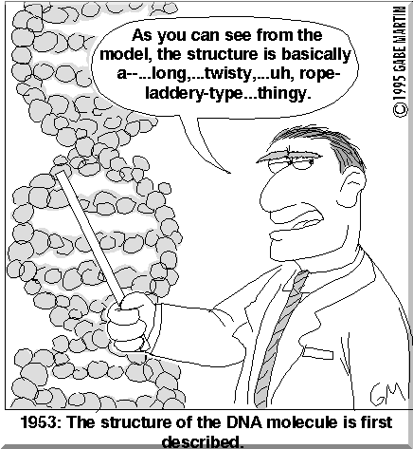
What not to study . . . .

Slide 8
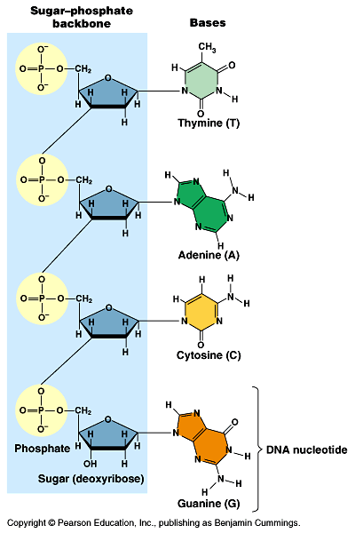
THYMINE
ADENINE
CYTOSINE
GUANINE

Slide 9
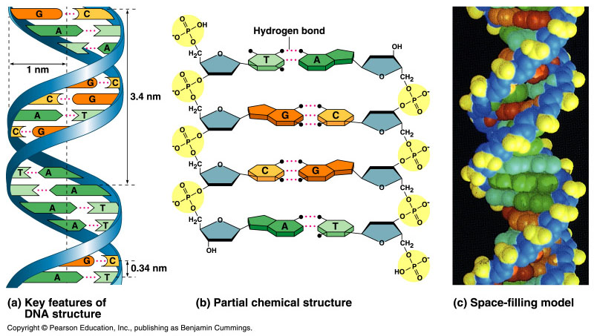

Slide 10
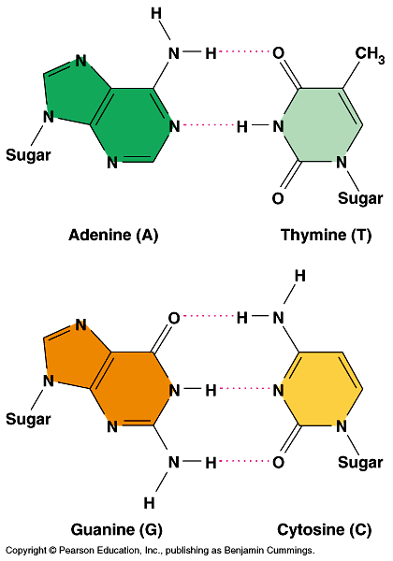

Slide 11
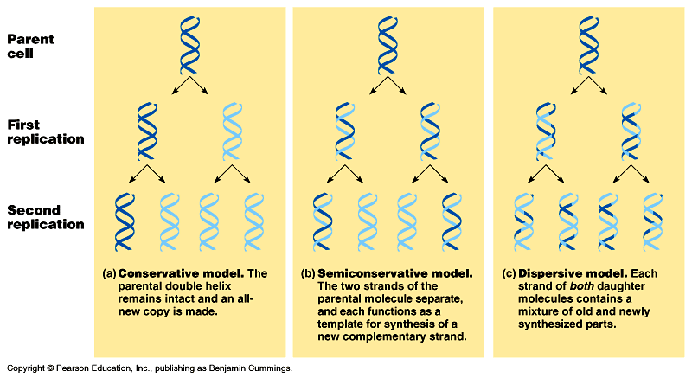

Slide 12
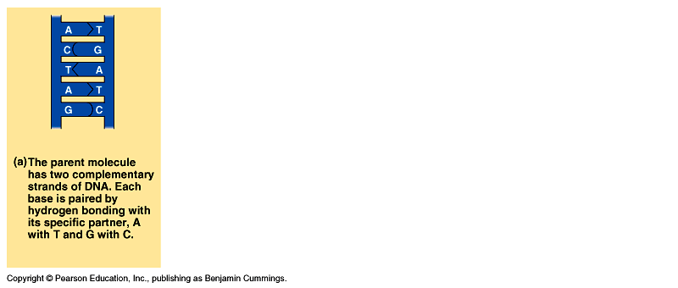

Slide 13
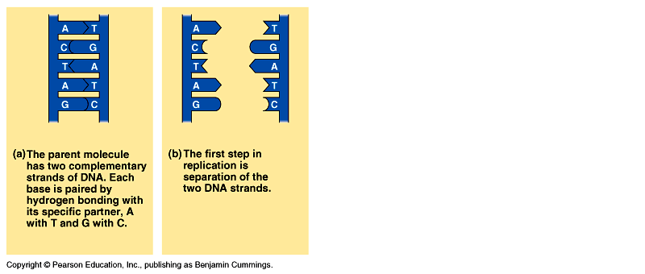

Slide 14
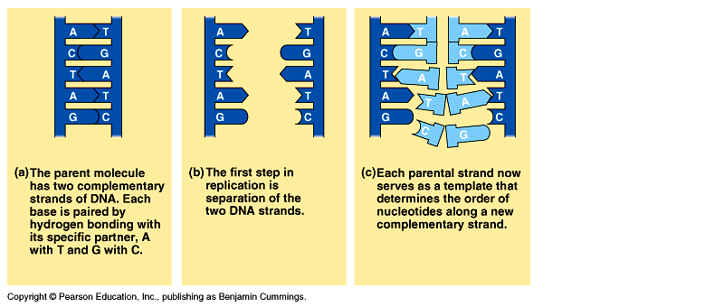

Slide 15
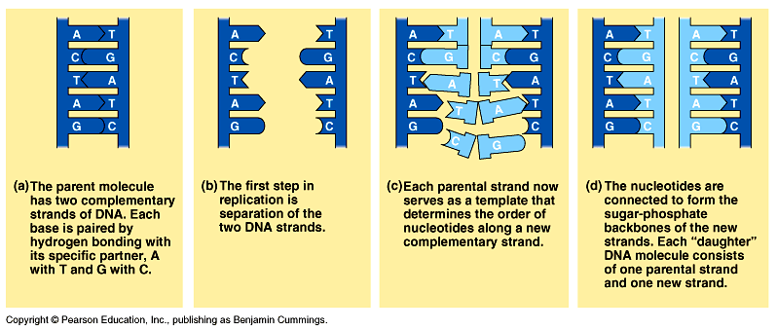

Slide 16
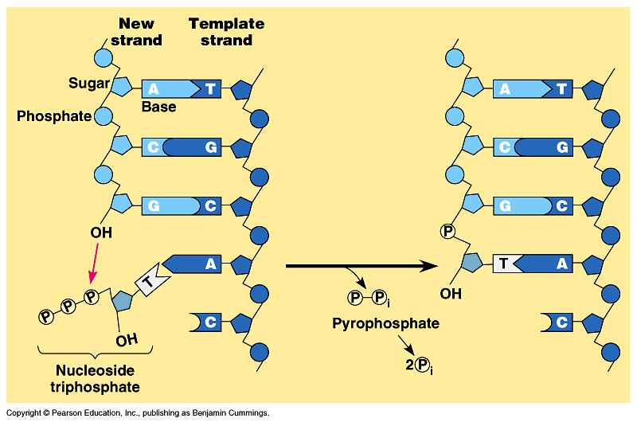

Slide 17
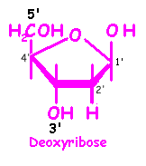
Deoxyribose carbons

Slide 18
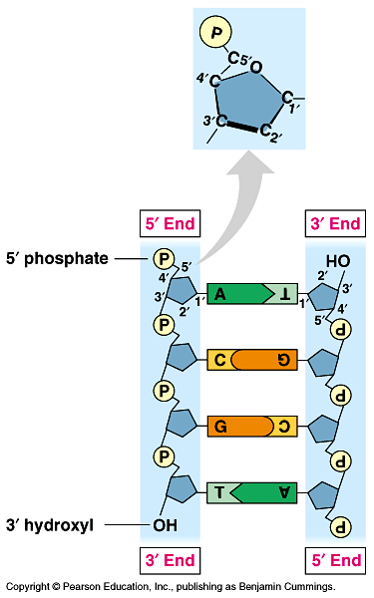

Slide 19
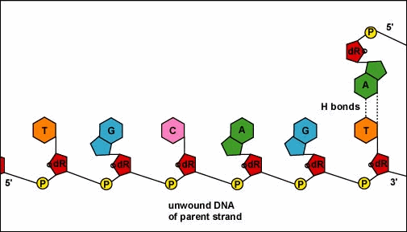

Slide 20
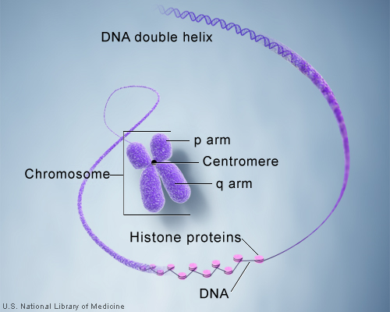
DNA = Chromosomes?
When the DNA is not dividing, it is wrapped around proteins called histones.
The combination of DNA and histones make up a chromosome

Slide 21
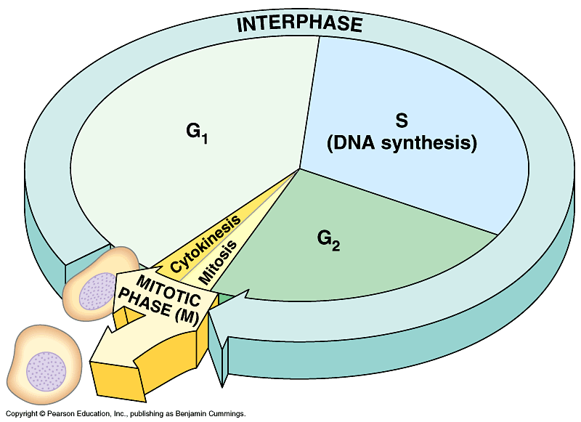
The cell cycle
One stage of interphase includes a synthesis stage (S) – this is where DNA is replicated so that each new cell can have its own set of DNA. We call this synthesis stage: DNA replication

Slide 22
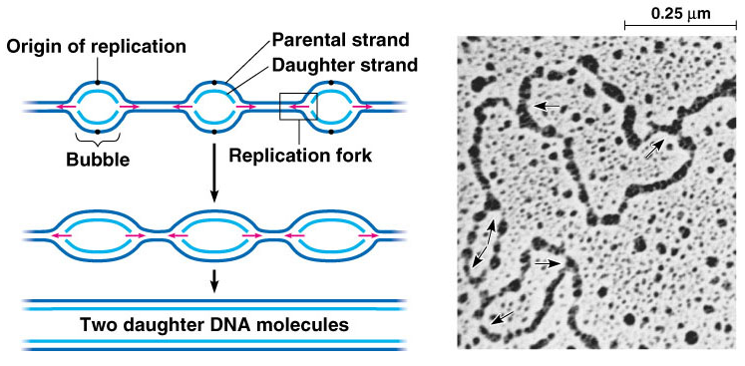

Slide 23
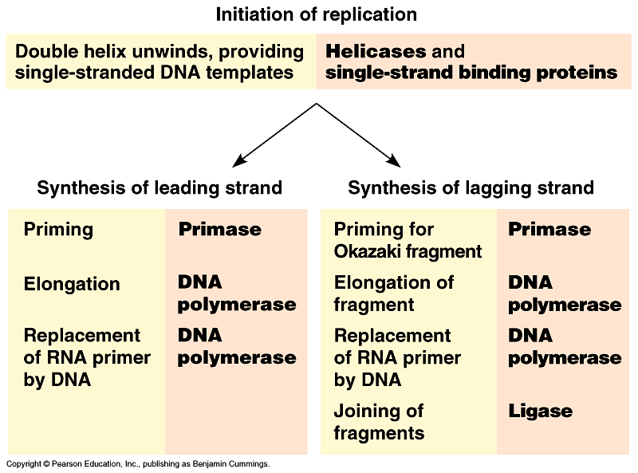

Slide 24
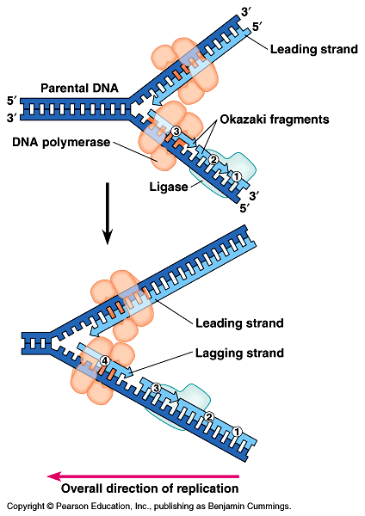
Rules of Replication
DNA read from 3’→5’
DNA is built from 5’ →3’
Helicase opens DNA
DNA polymerase builds DNA
Primase used to start both strands
DNA ligase acts like the DNA super glue

Slide 25
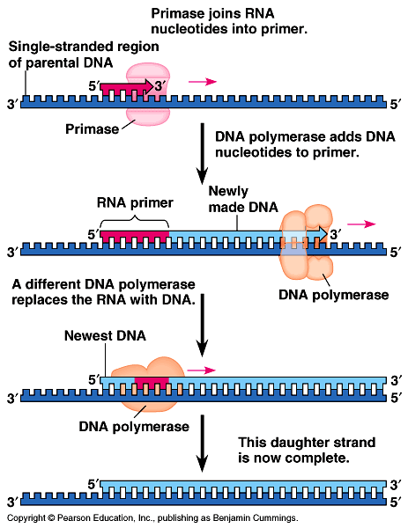

Slide 26
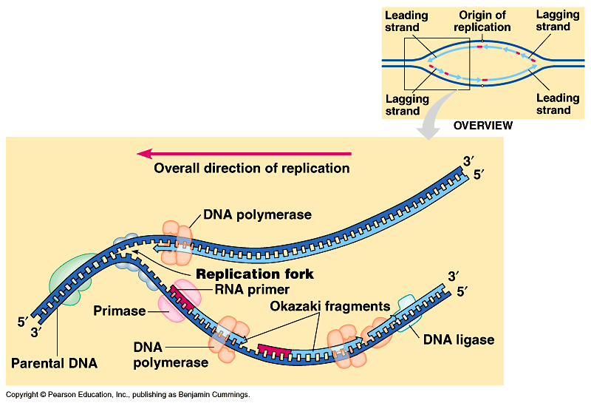

Slide 27
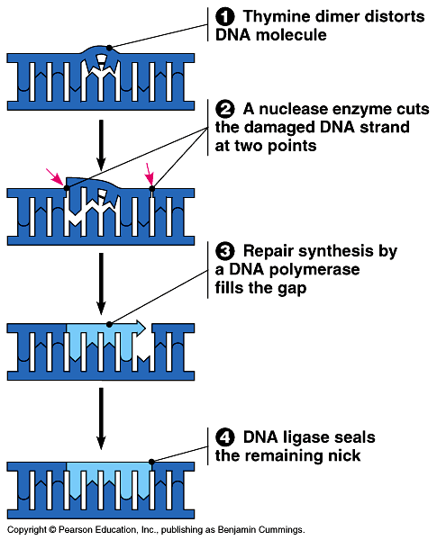

Slide 28
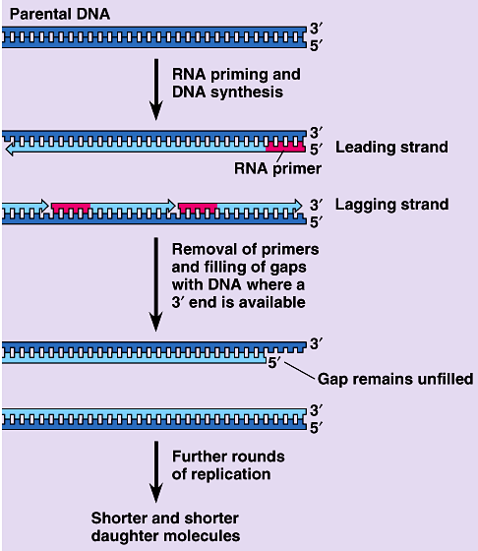

Slide 29
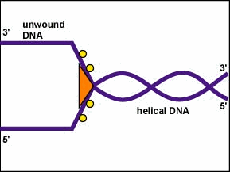

Slide 30
